Slide 1

So many choices.....
I think my best choice would be to apply for French Canada.
It is so tempting.
Go Go Go
Click and wish for the best.

Slide 2
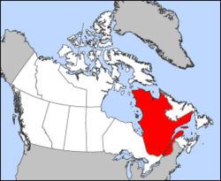

French Canada =
Province of Québec
The cradle of french america

Slide 3
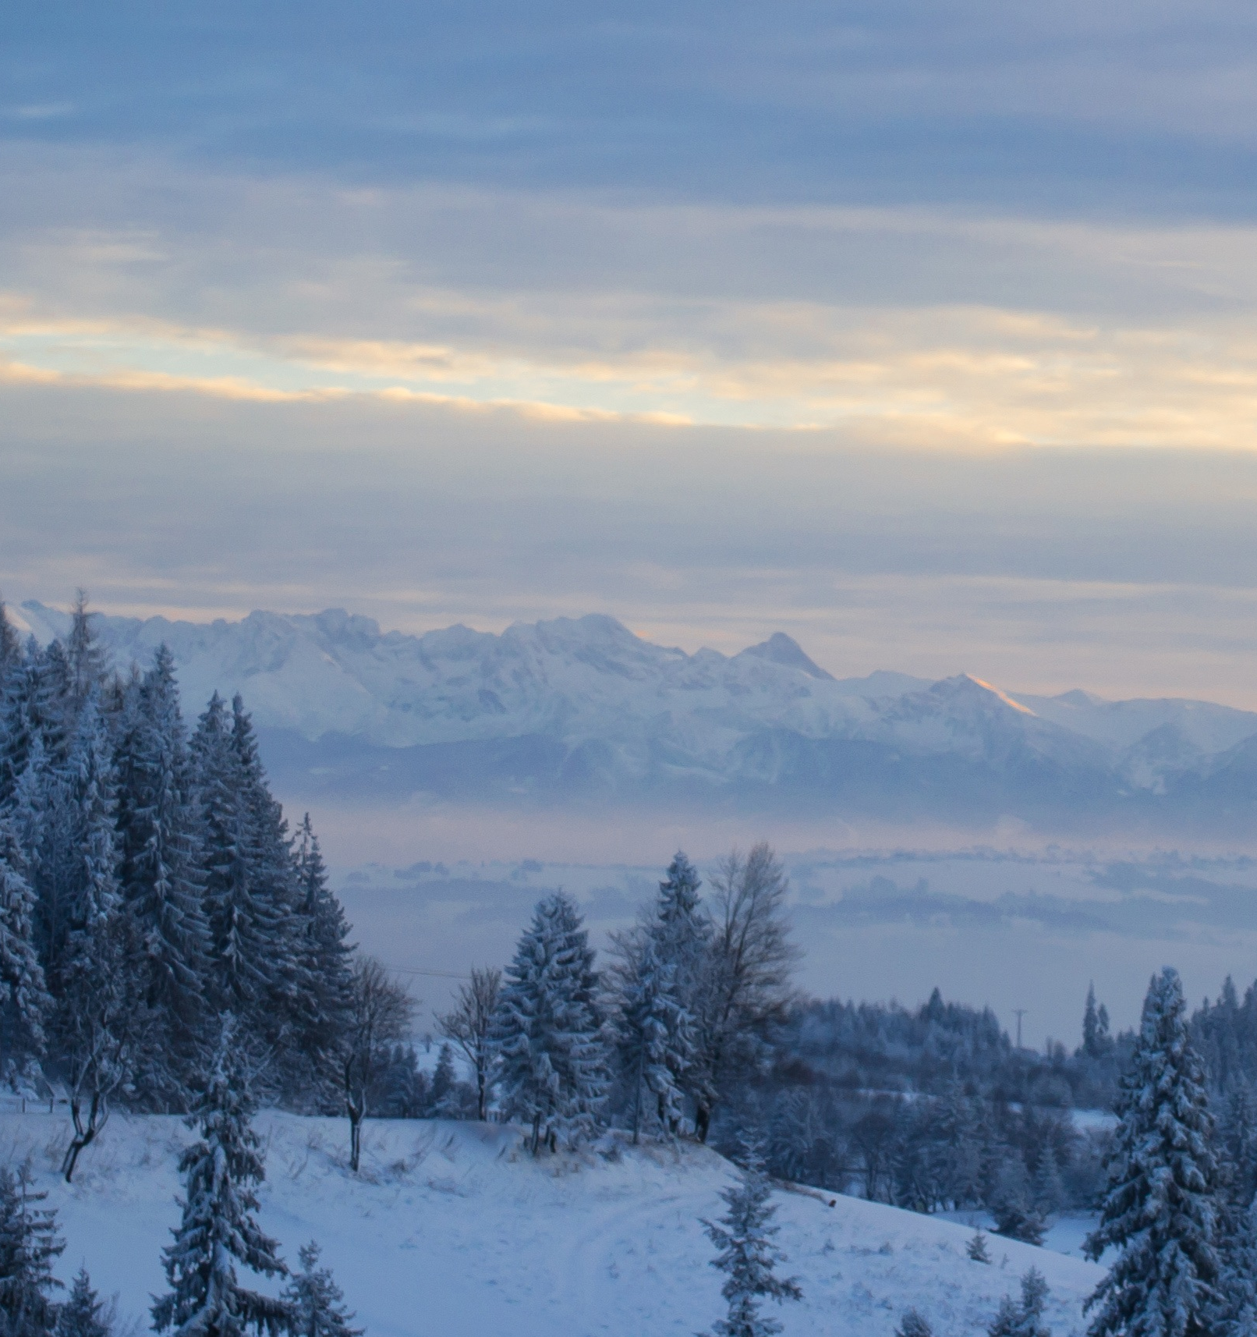
Who are we?
Descendants of French immigrants who develop their own language being cut off from the mother land.
We are resilient
We live in a country with long winter and we have learned to adapt
We are Canada's largest province
We are 3 times bigger than France but with only 8.5 million inhabitants.

Slide 4

Why choose French Canada
Because we ARE DIFFERENT

Slide 5
And simply because your students want to learn French of course

Slide 6
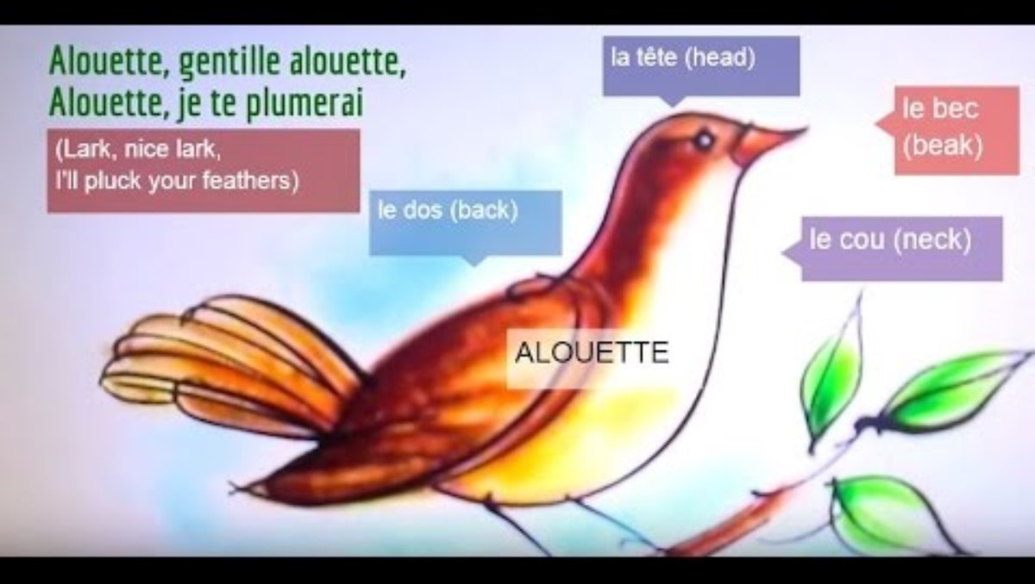
And also the real lyrics of Alouette once and for all.....

Slide 7
But there is so much more.....
Your students want to experience our particular activities and we promise there will never be a dull moment while here.
They want to see with their own eyes our province's immense territory.
They want to experience our differences
AND WE WILL TRY TO LET THEM EXPERIENCE IT ALL

Slide 8

''Chez nous''
We are proud of our language, and happy to have the opportunity to accompany your student to master it while with us.

Slide 9

We love to show our uniqueness to our exchange students

Slide 10

And from September to June, your students will have plenty to see and do .....
Attachez vos tuques avec de la broche!
Hold on to your hat!

Slide 11
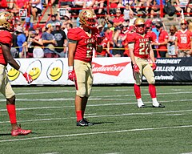
In September, we'll teach your students the rules of Canadian Football
ThePhoto par PhotoAuthor est fournie sous licence CCYYSA.

Slide 12
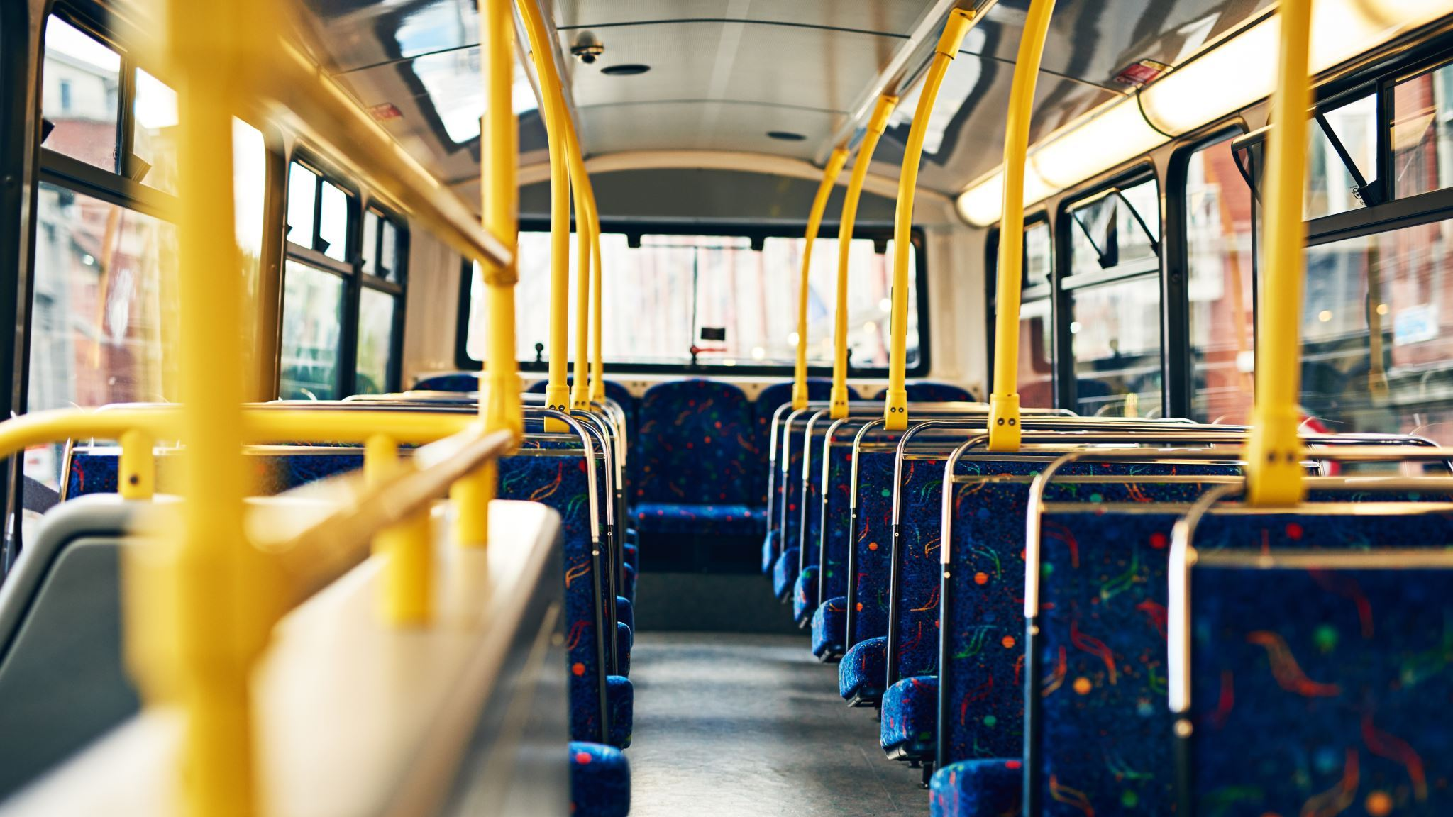
And your students will experience their first ride to school in a yellow bus

Slide 13
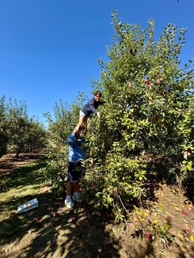

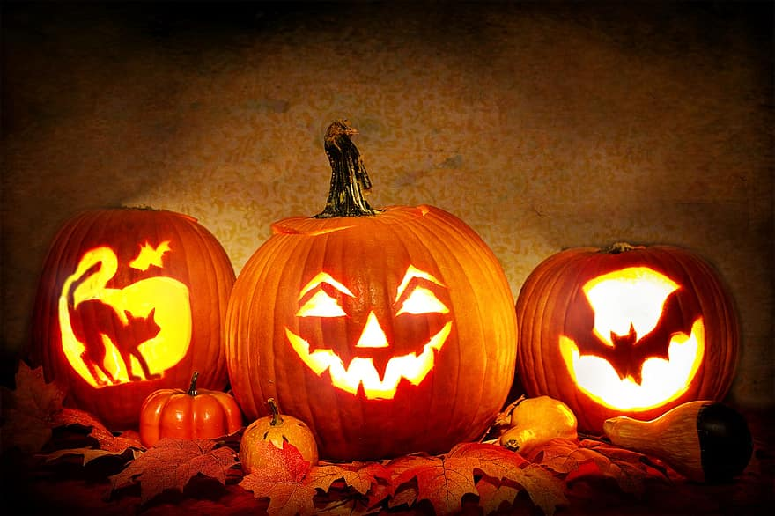
In October your students will desire to live our fall to its fuellest
Lasse Boerner from Germany

Slide 14
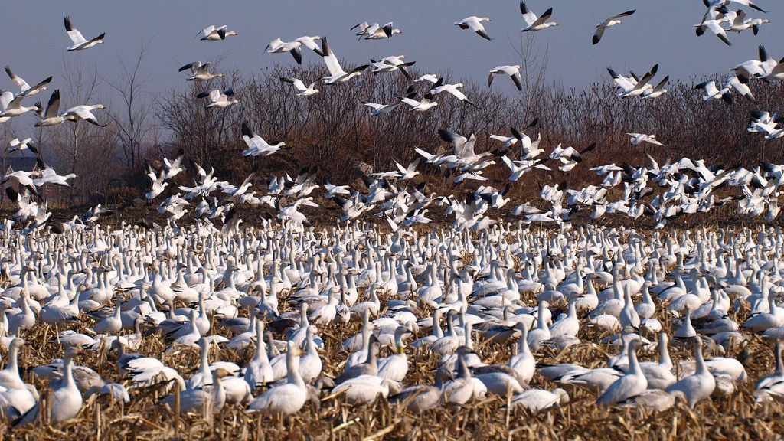
Later, they'll watch thousand of geese invade our fields and shores while travelling south for the winter
And come back in spring

Slide 15
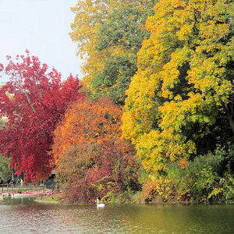
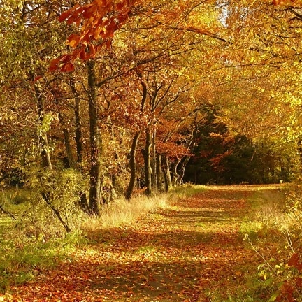
And why not become the spectator of our
''Fall Colors Festival''

Slide 16
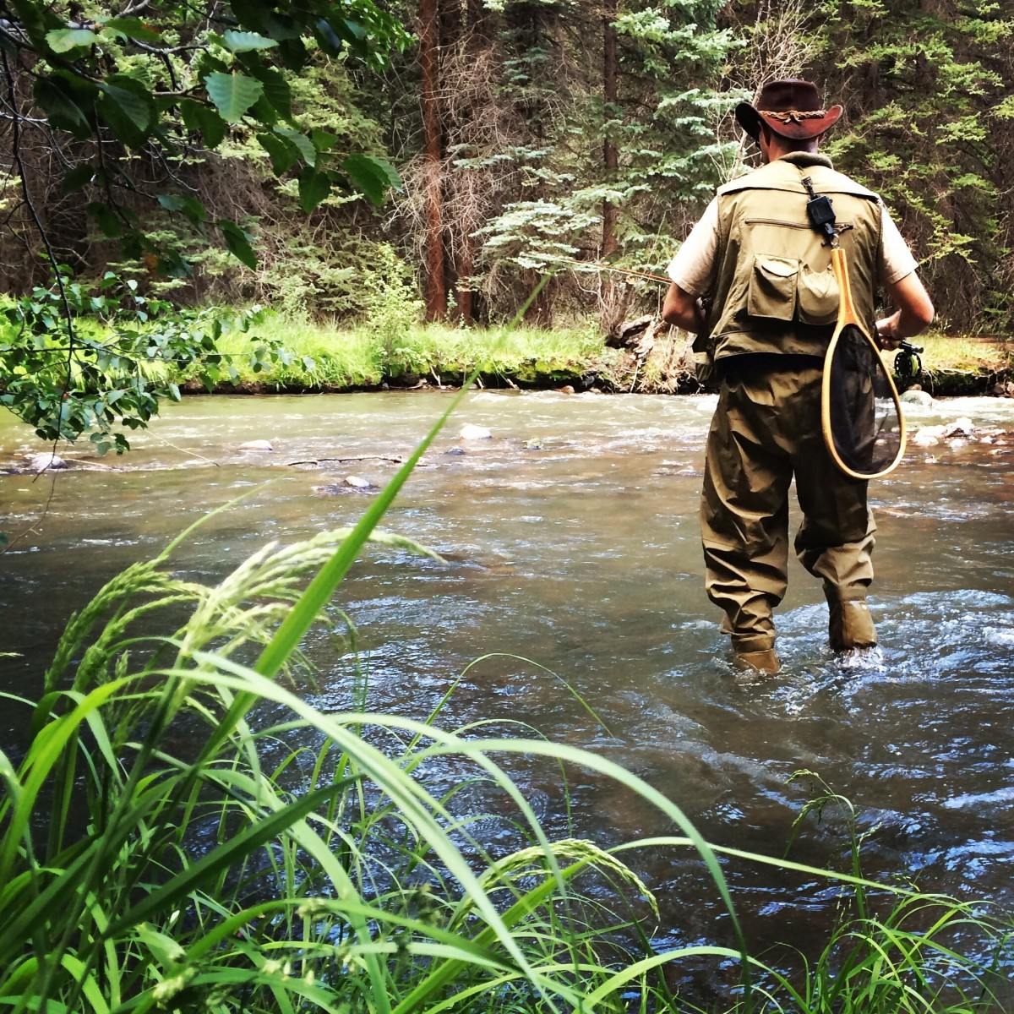
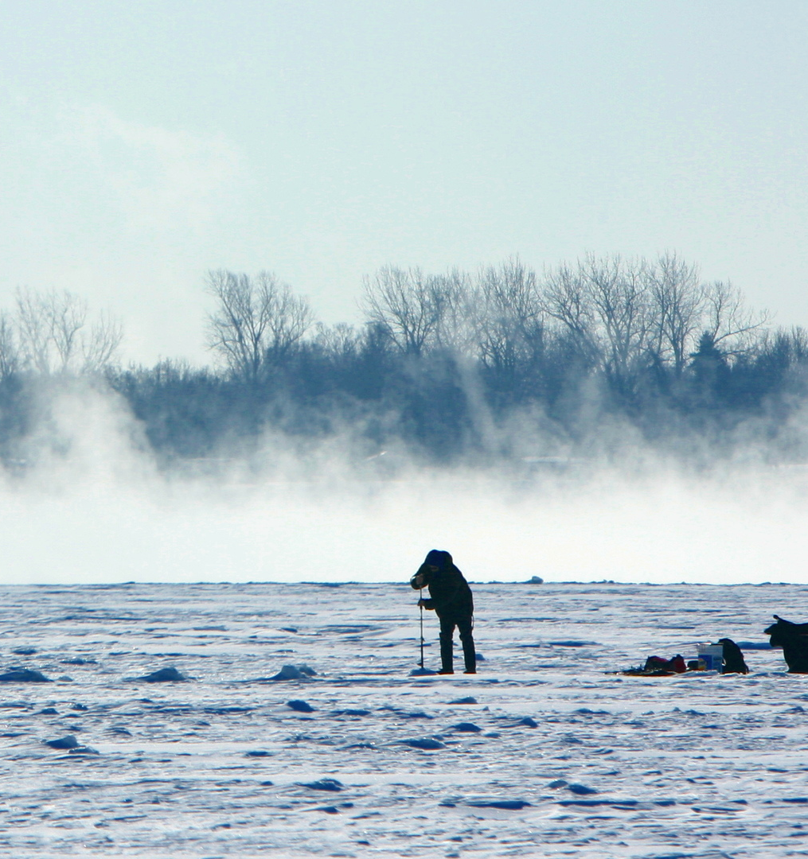
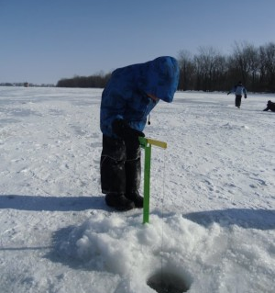
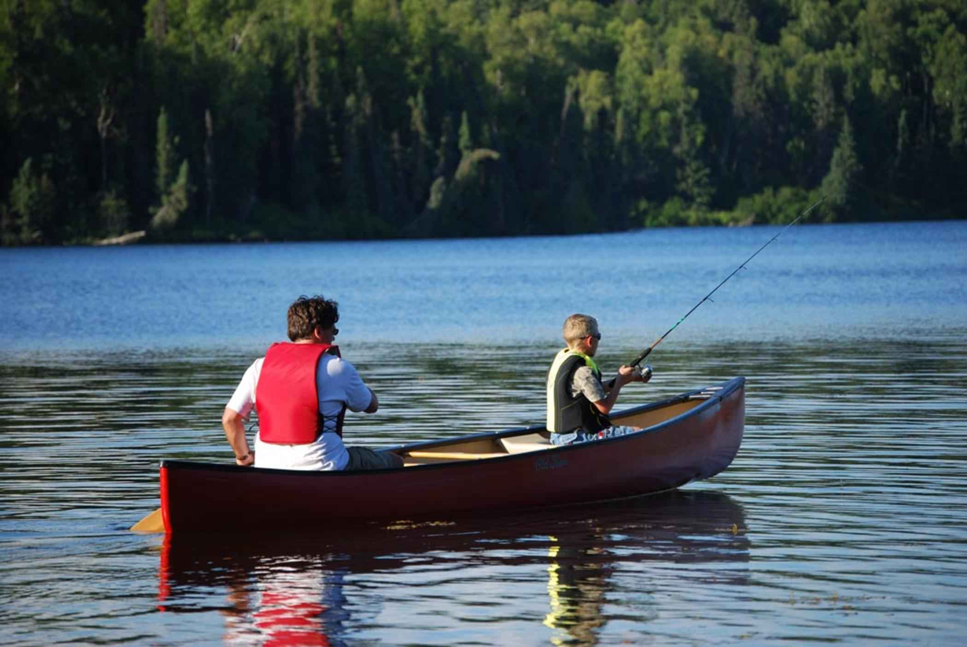
Nowhere else, could your students experience fishing in so many ways?

Slide 17


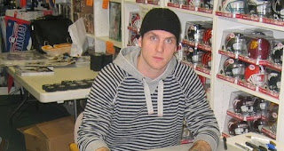
November – Watch out!
Tuque will definitely be a word to learn and know

Slide 18
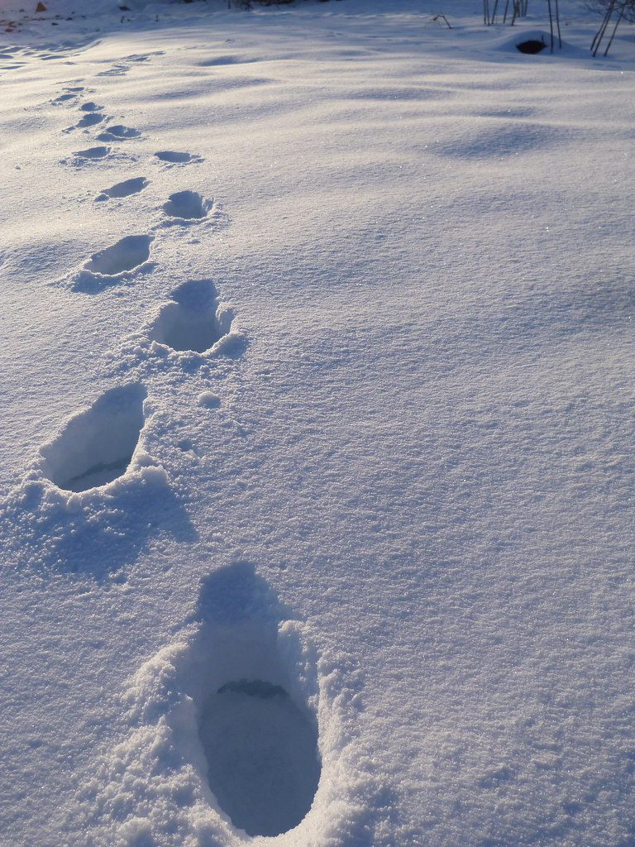
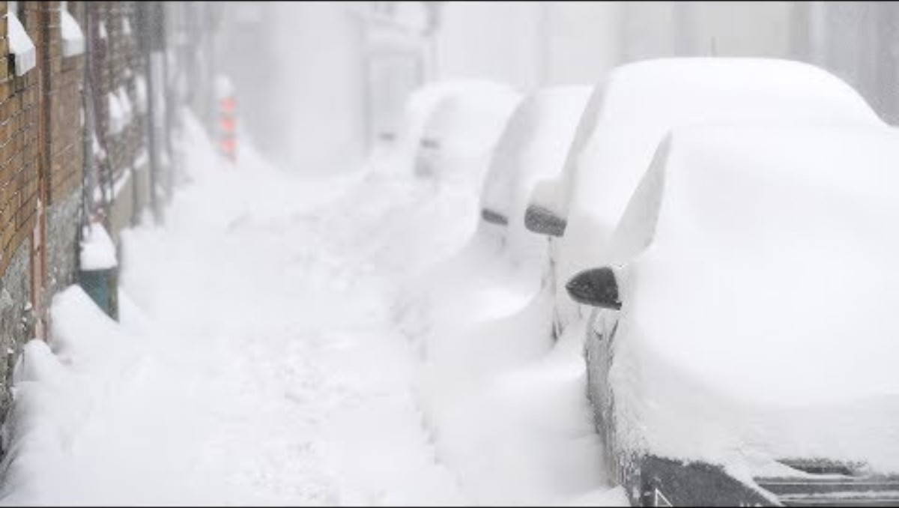
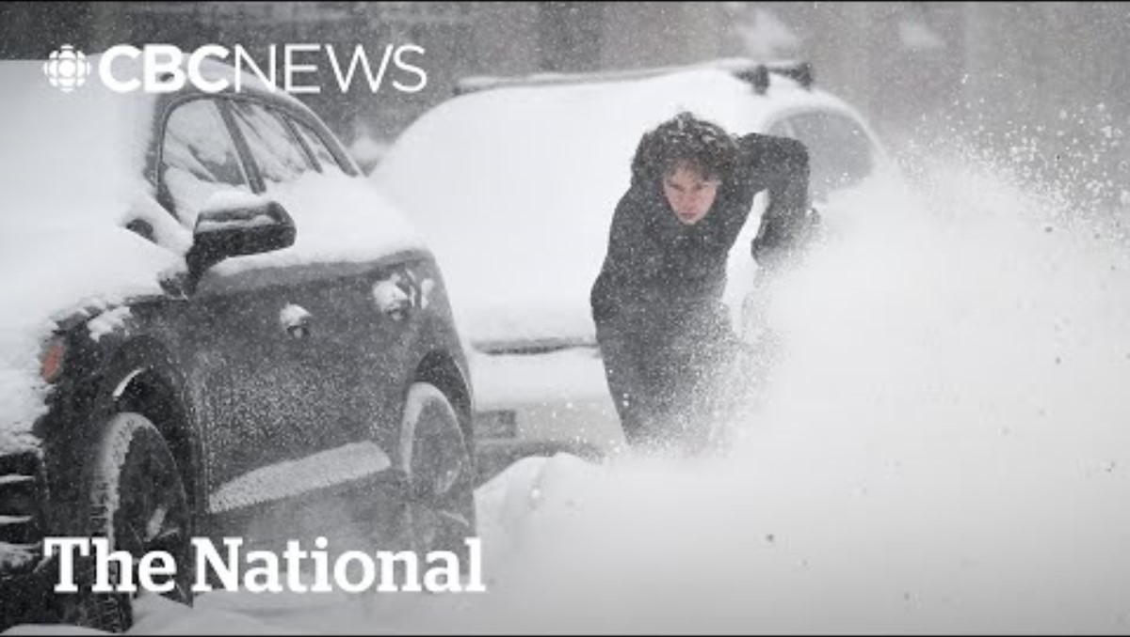
Winter coming your students will experience it with envy??? Well maybe...
They'll be so excited with the first snowflake they see and touch
….. but by end of April, they'll start to believe that it will never end.

Slide 19
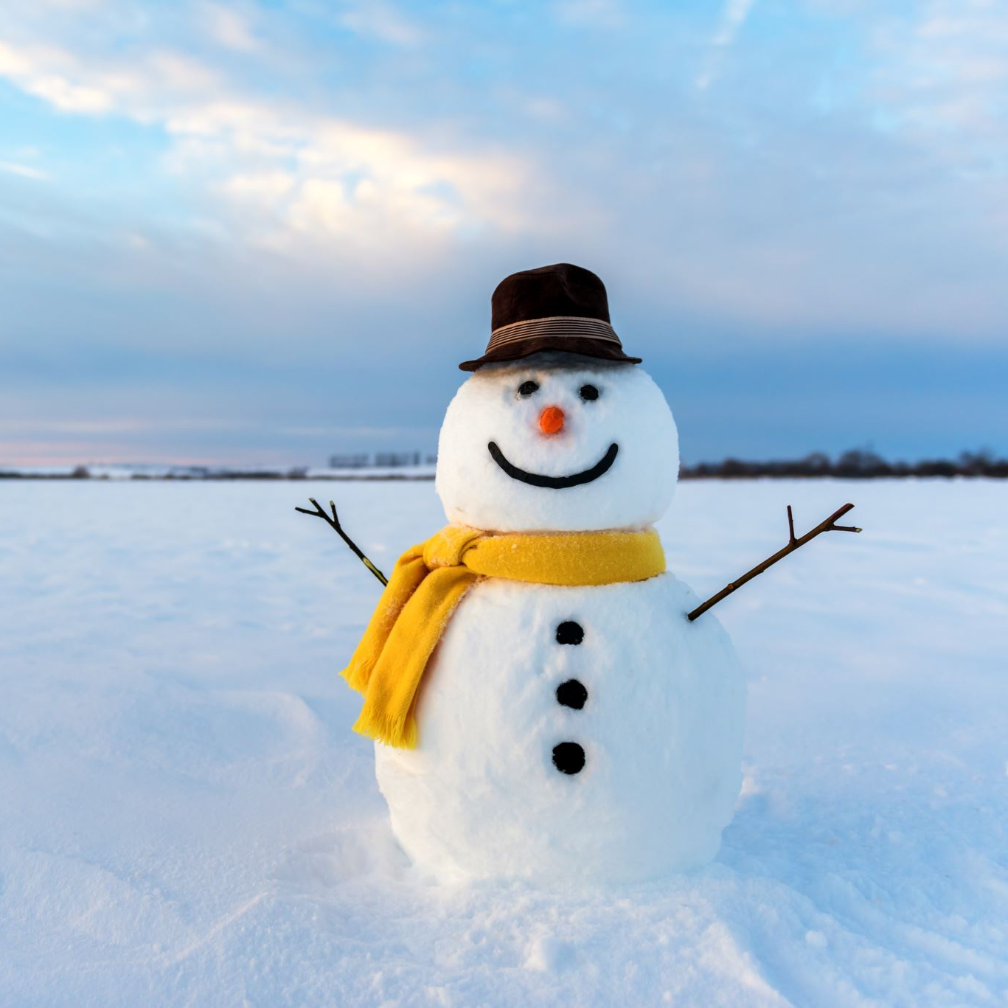
Good for your students, they'll become Snowman's builders for the first time of their life

Slide 20
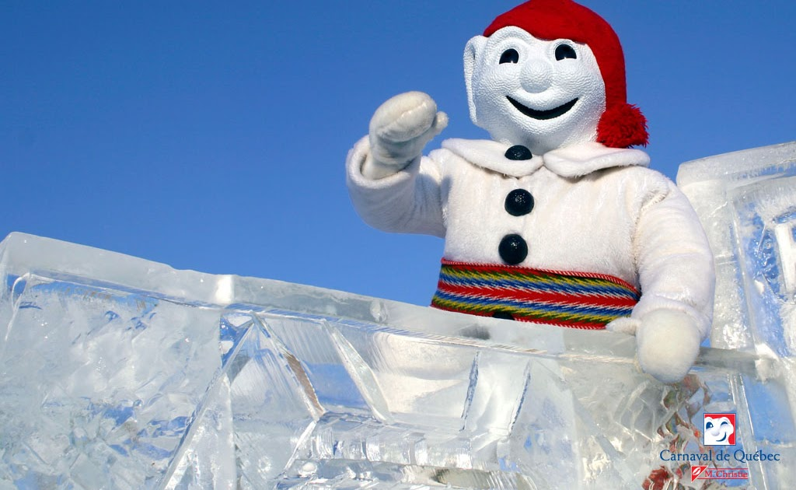
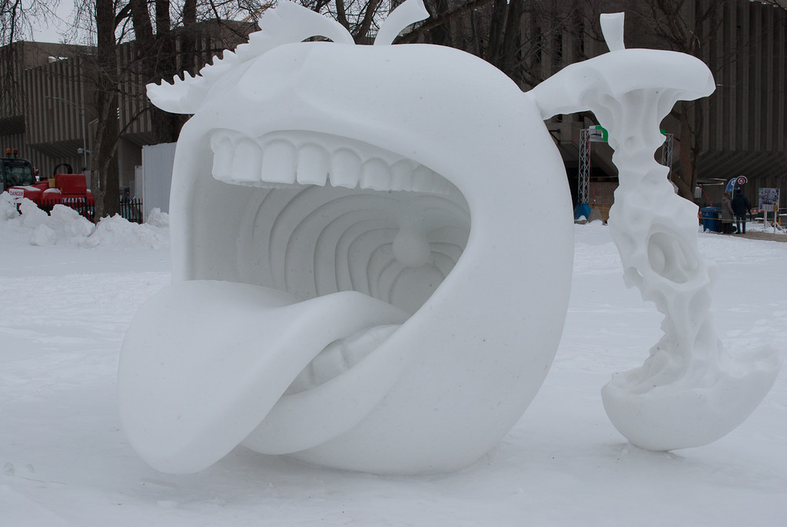
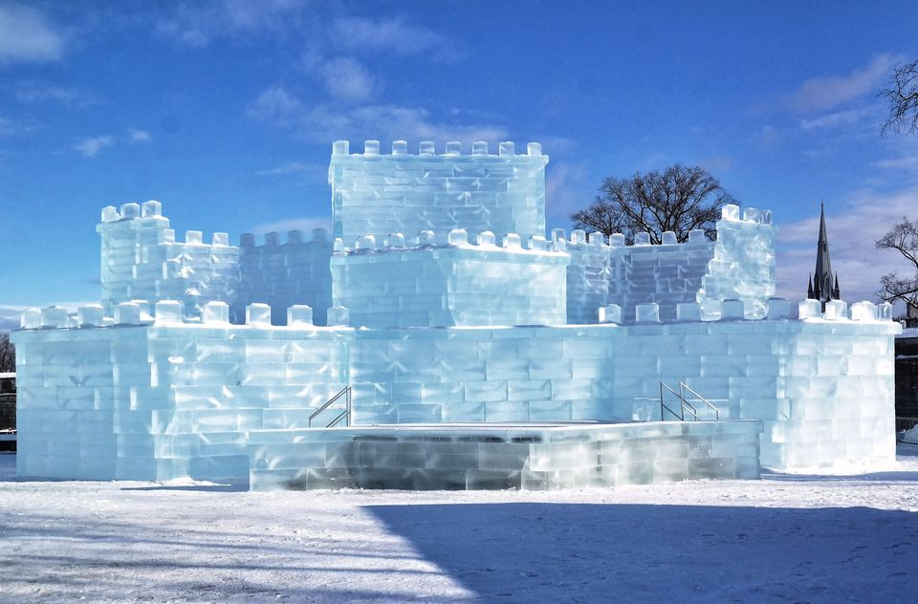
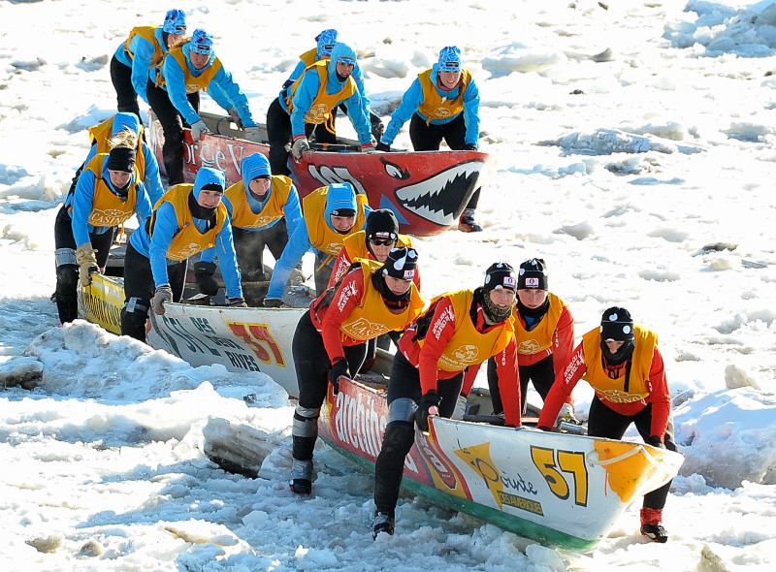
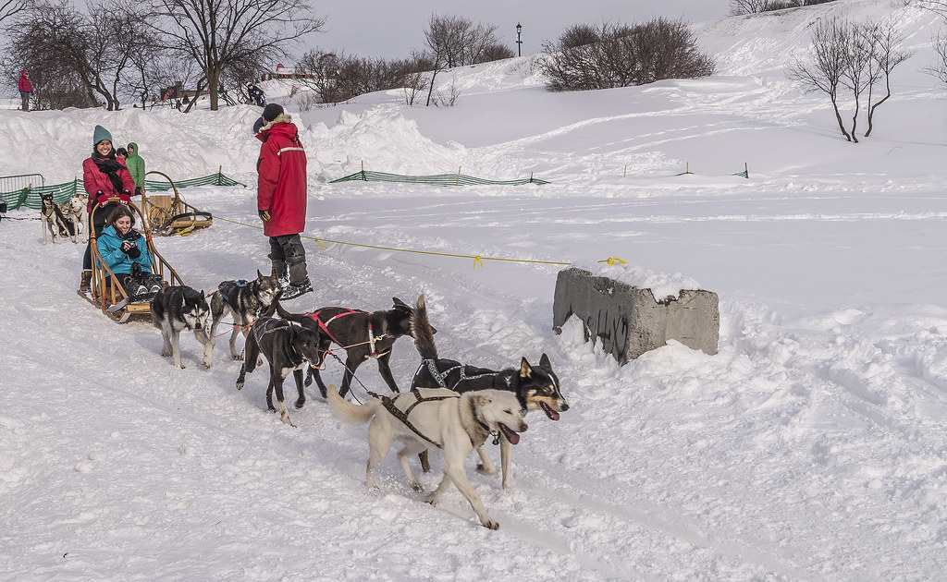
In February, experience Québec City winter Carnaval

Slide 21
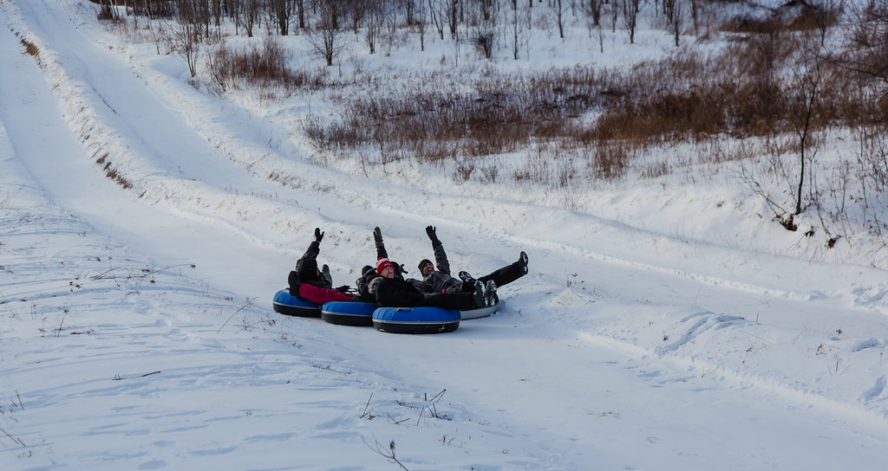
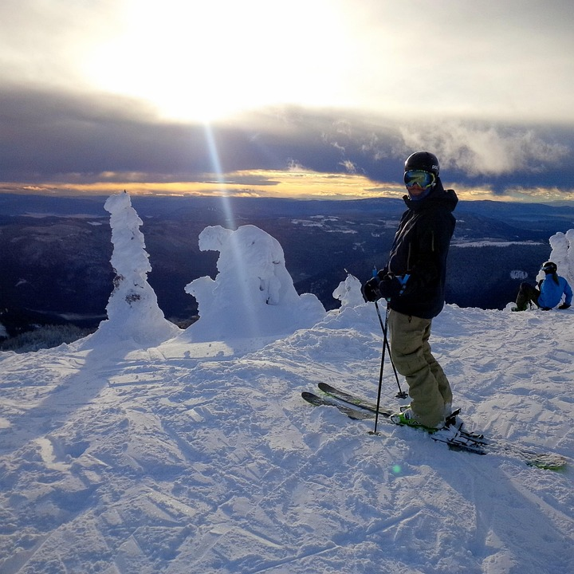
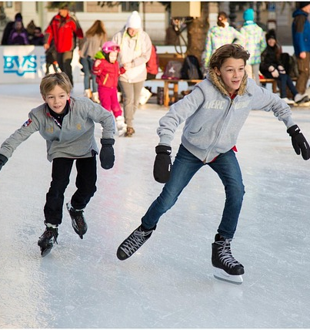
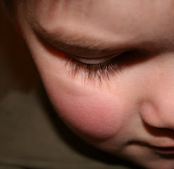
And why not experience all of those sports in one day if they can brave our –30 Celcius
With the possibility of cheeks' frost bite

Slide 22
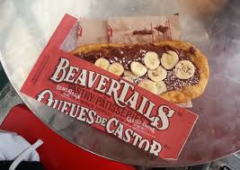

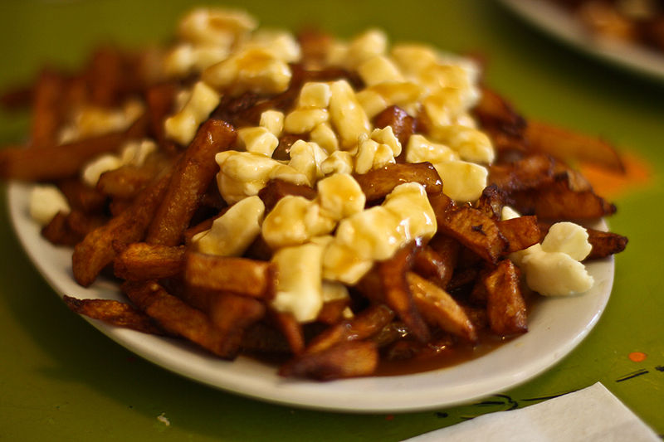
But will always have the possibility to forget their pain. Nothing like our national comfort food !

Slide 23

In our Host family your students will learn to:
Experience family life
Complete their apprenticeship of a new language
Participate to family events
Become part of the family
Discover, experience and learn that our world is different but enjoyable nevertheless

Slide 24

And spring coming, will come time to think of going home
But never without experiencing

Slide 25
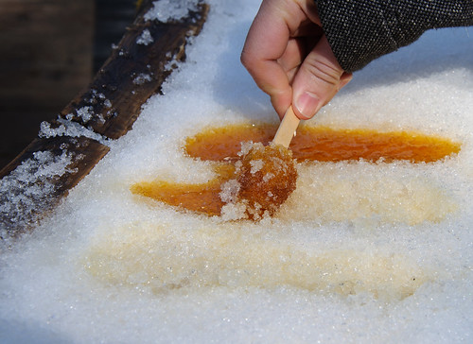
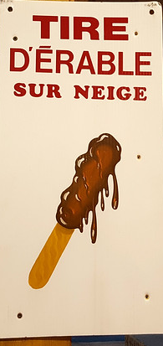
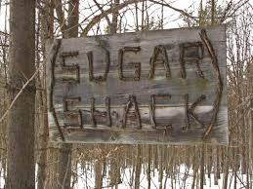
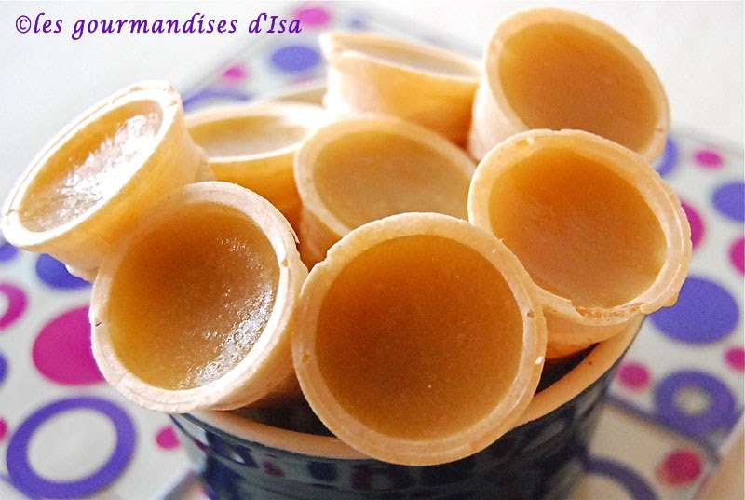
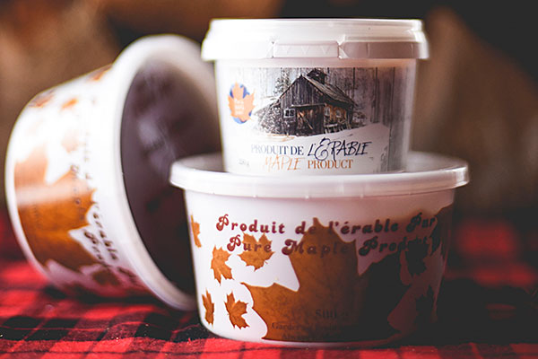
The Sugar Shack and our Maple syrup and toffee
ThePhoto par PhotoAuthor est fournie sous licence CCYYSA.

Slide 26

And then June will be there …..
To experience the graduation ceremony and ball

Slide 27

And to Celebrate
'' la St-Jean- Baptiste'' on June 24th, as a Quebecer

Slide 28

And 7 days later
CELEBRATE
Canada
National Day

Slide 29

And finally when the experience will be over, we hope that our students will keep Québec in their heart forever failing to get it tatooed.

Slide 30

The End

